Slide 1
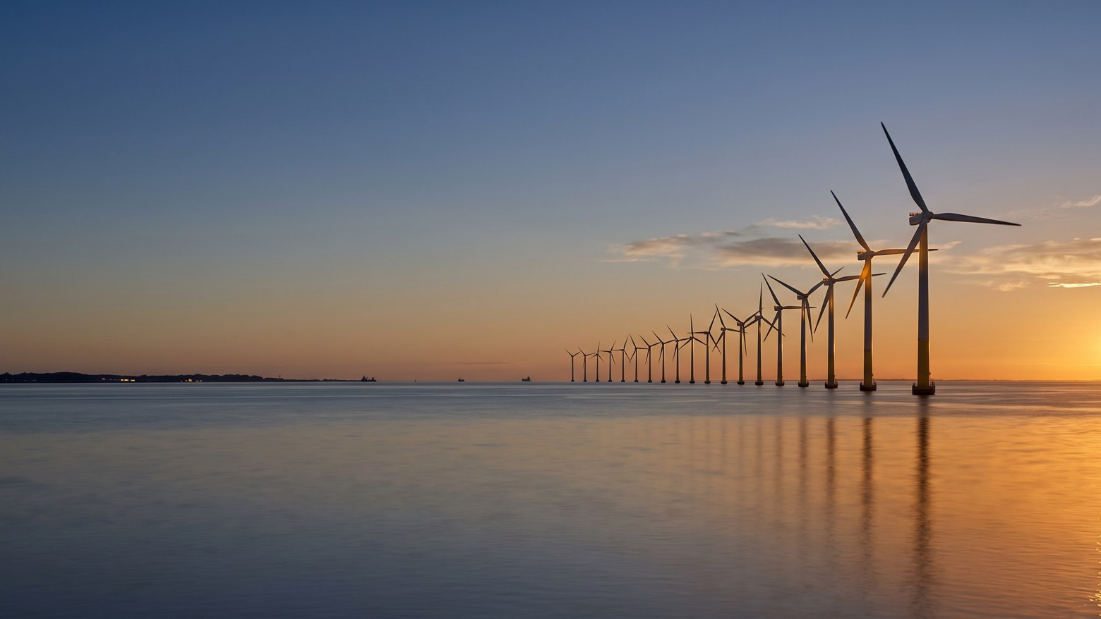
WEYLAND ENERGY
Powering the North
Creative concept · Fjord & Harbour Creative for Weyland · April 2026

Slide 2
“Engineers don't want to sell the energy transition. They want to build it.”
— Interviews with 22 engineers, March 2026
WEYLAND ENERGY · Powering the North – creative concept
2

Slide 3
The idea
• Real places, real people – our assets and the people who build them
• Headline formula: [what we build] + [what it means]
• Calm, documentary photography – no stock
• Sign-off: Clean power, built to last.
WEYLAND ENERGY · Powering the North – creative concept
3

Slide 4
Key visual 1 – Offshore
“480 MW. Built by people who like a challenge.”

Slide 5
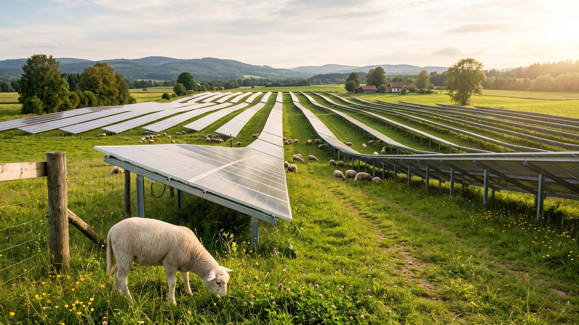
Key visual 2 – Land
“Good neighbours make good power.”

Slide 6
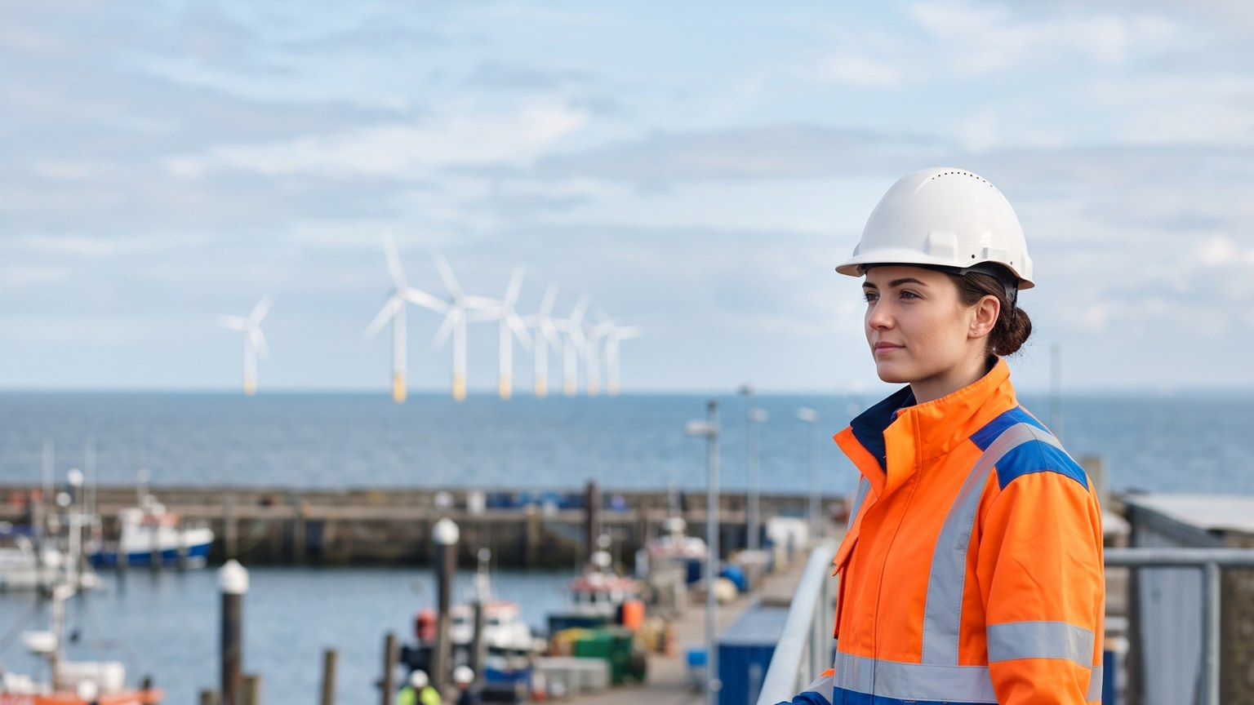
Key visual 3 – People
“Your next project is 38 km offshore.”

Slide 7
Channel roll-out
Channel | Format | Visual
LinkedIn | Single image, carousel, 30 s video | All three
Hamburg Airport | DOOH 9:16 | Offshore, People
Edinburgh Waverley | DOOH 16:9 | Offshore
Trade press | Full page, banner | Offshore
Summit booth | LED wall loop | All three
WEYLAND ENERGY · Powering the North – creative concept
7

Slide 8
WEYLAND ENERGY
Thank you
Fjord & Harbour Creative · Hamburg

